Slide 1

Day-3
Prepared by
Isysway Technologies

Slide 2

Topics Covered
IAM (Identity Access Management)
Identity and Access Management
IAM Overview and Policies
Users, Groups and Roles
IAM Best Practices
Configuring IAM Access

Slide 3
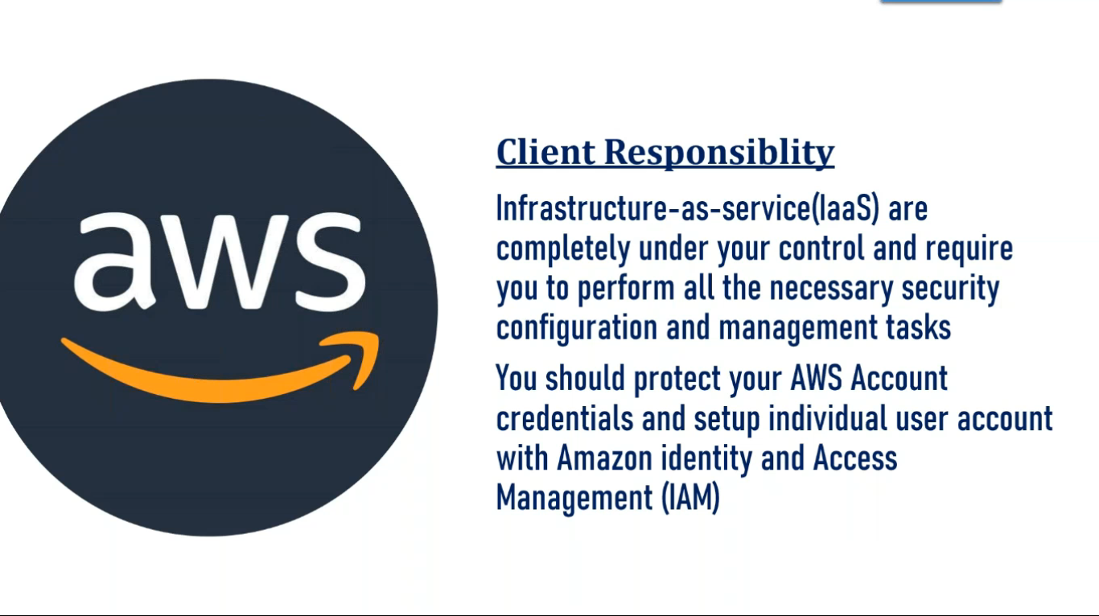


Slide 4
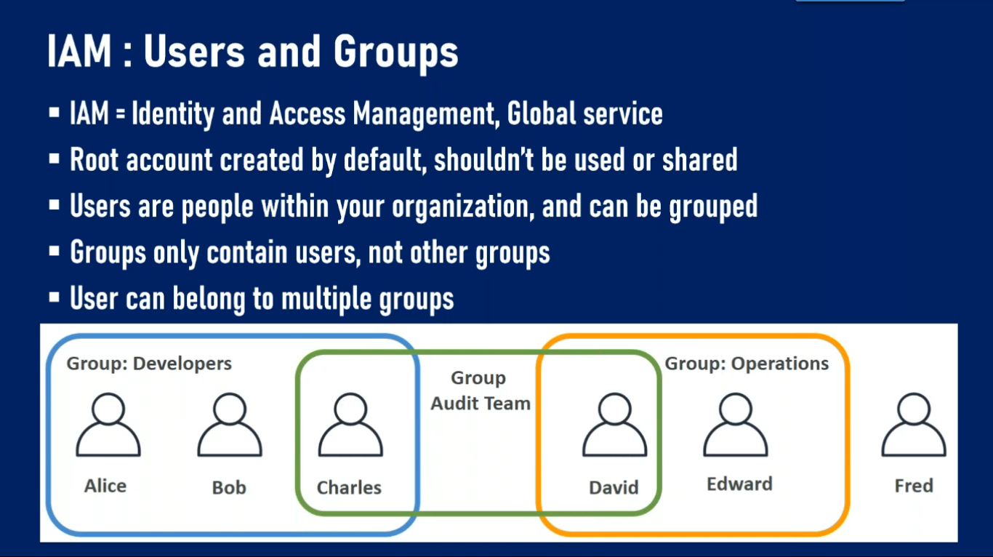


Slide 5
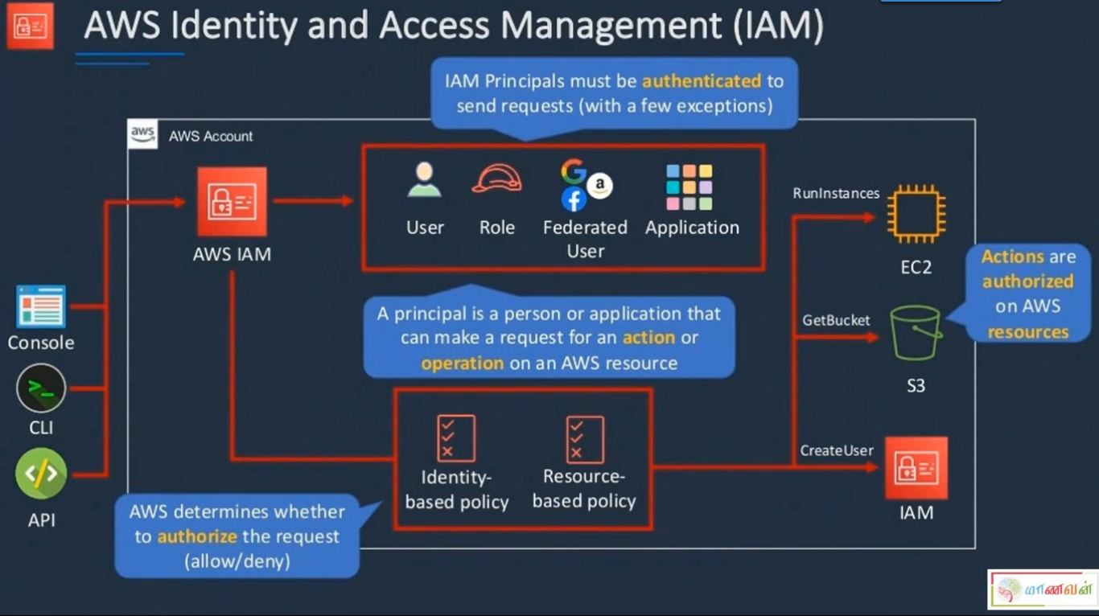


Slide 6
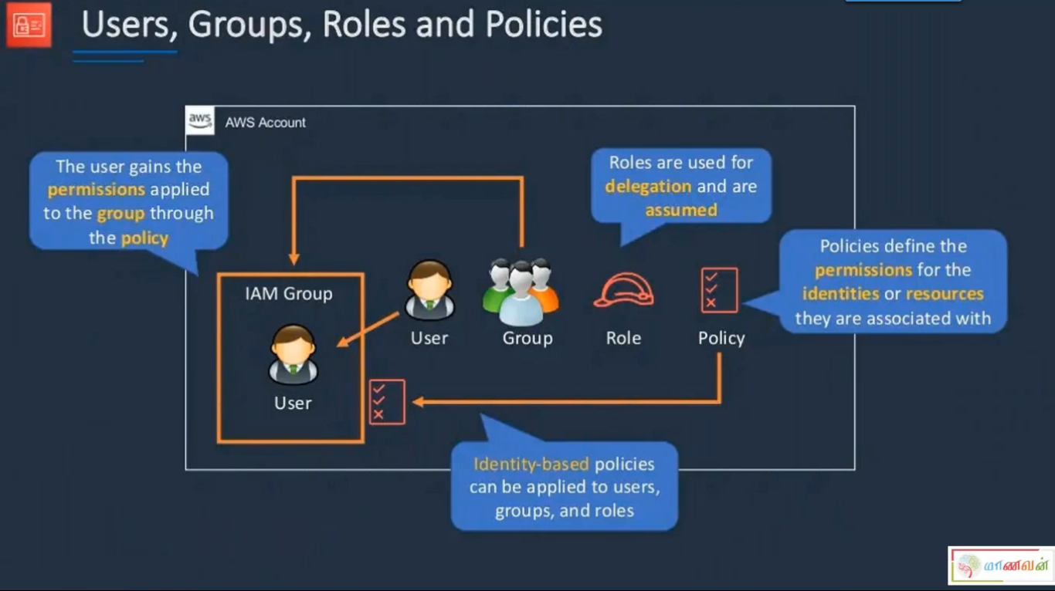

Slide 7
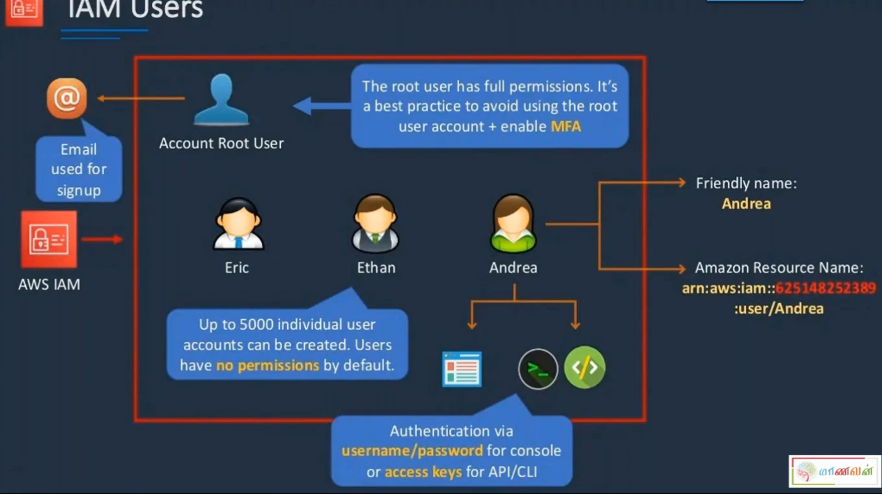

Slide 8
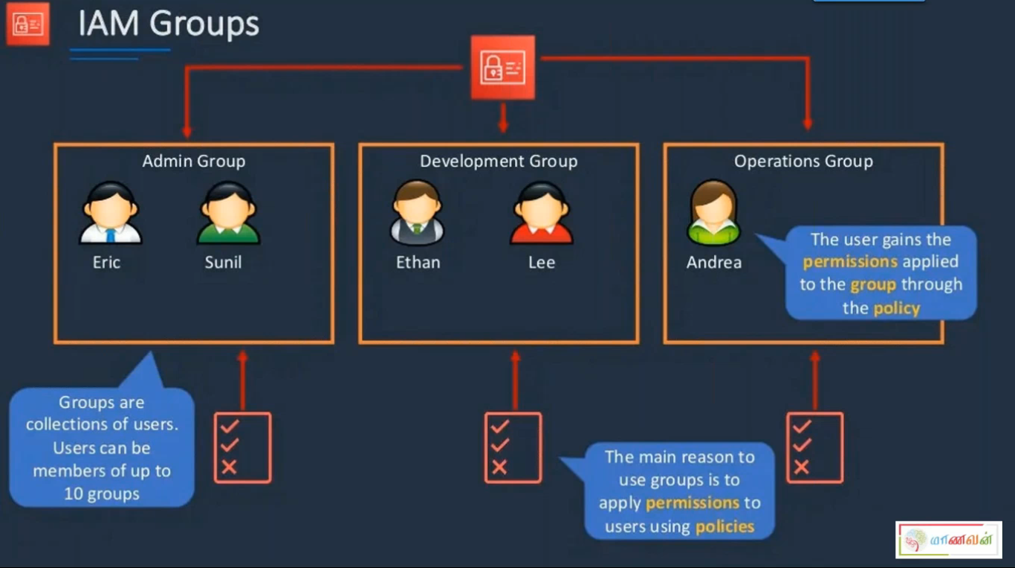

Slide 9
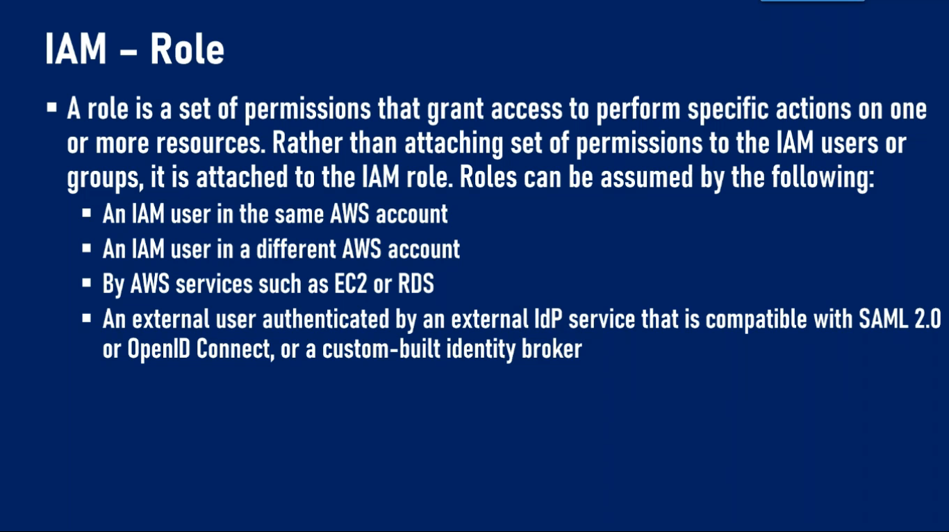

Slide 10
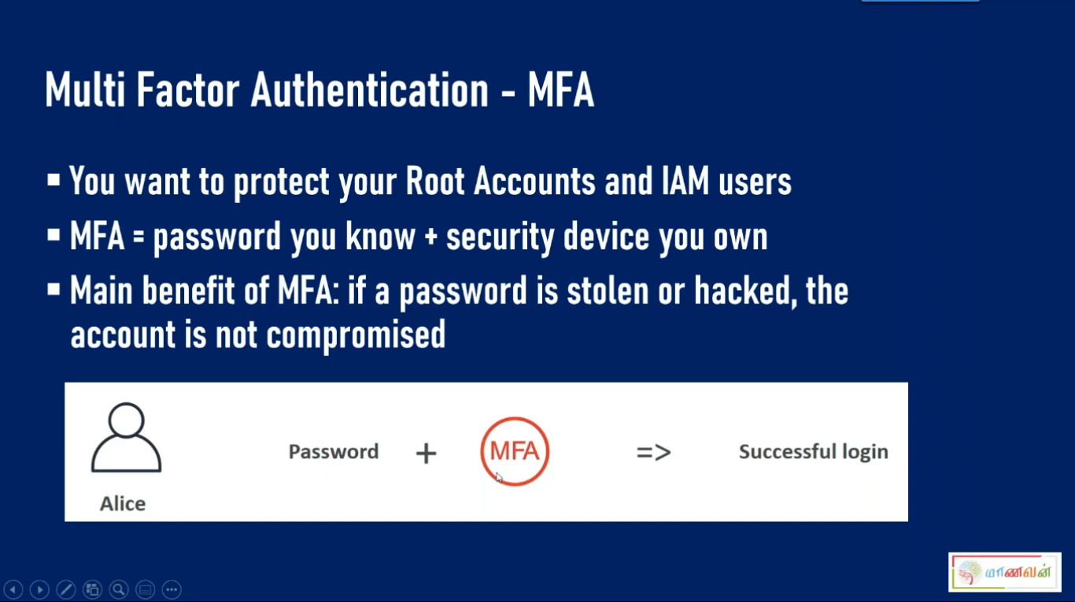

Slide 11
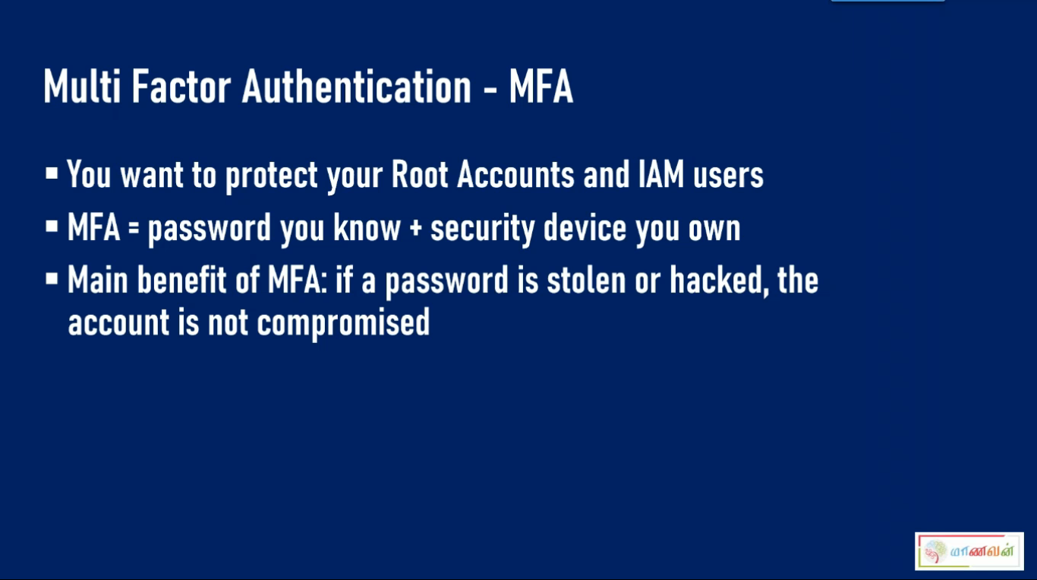

Slide 12
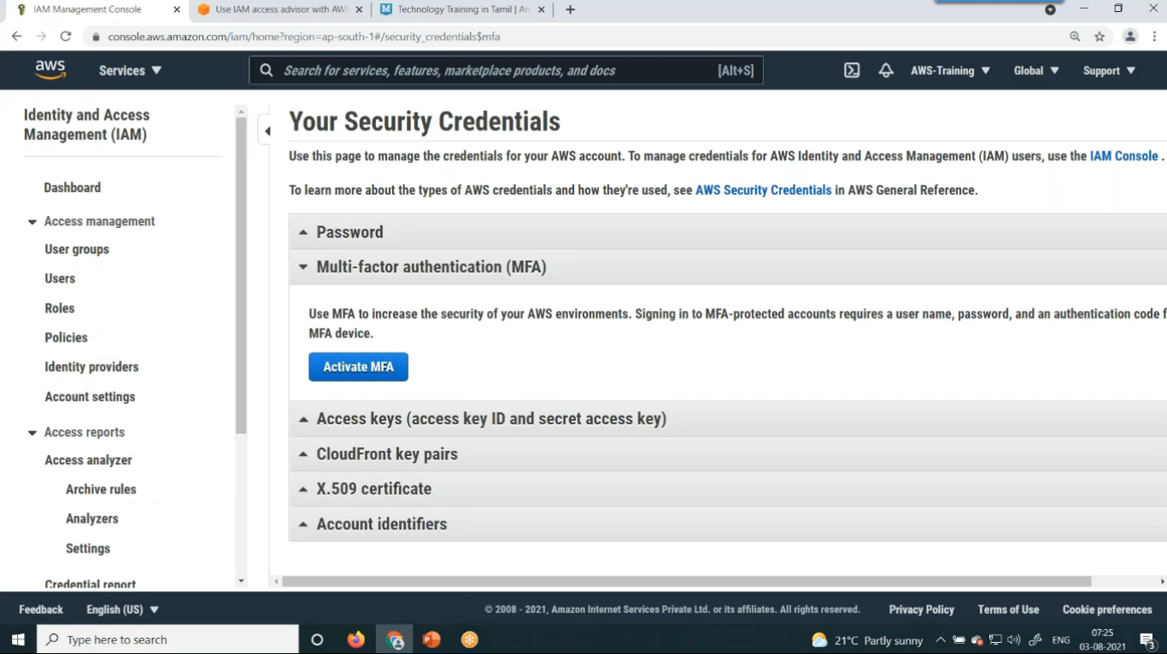

Slide 13
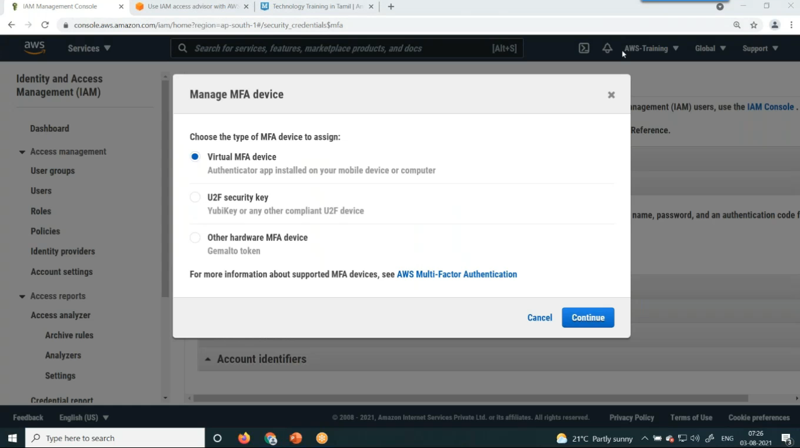

Slide 14
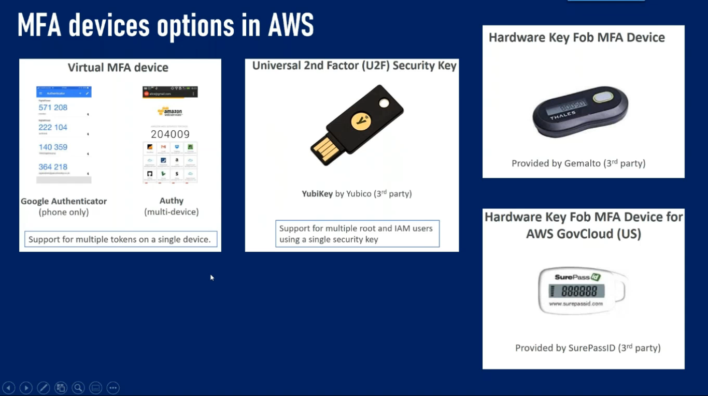


Slide 15
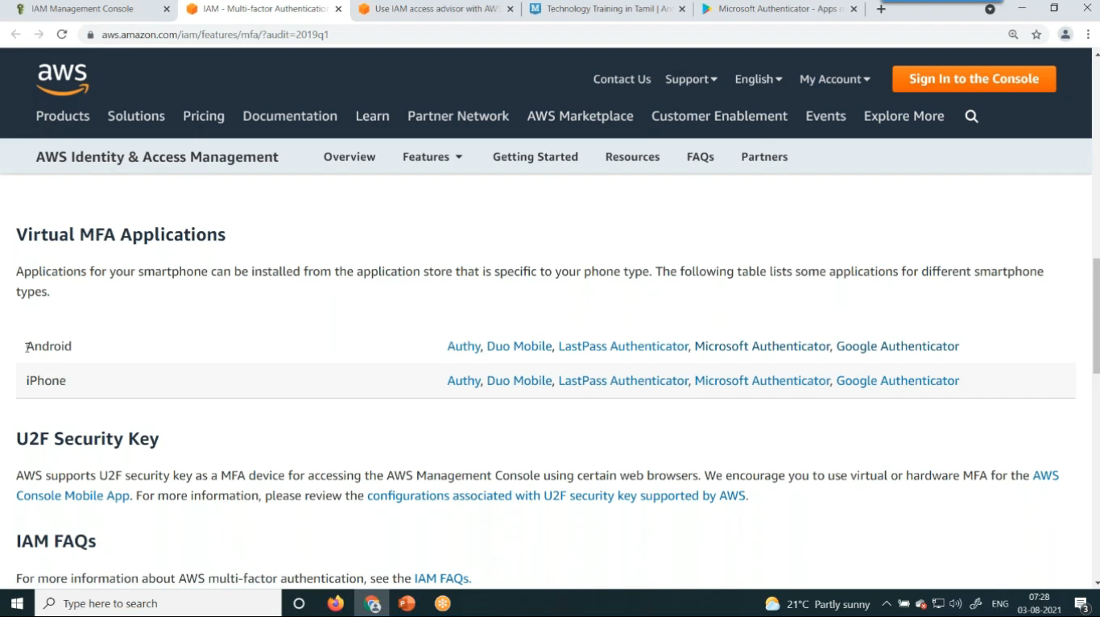

Slide 16
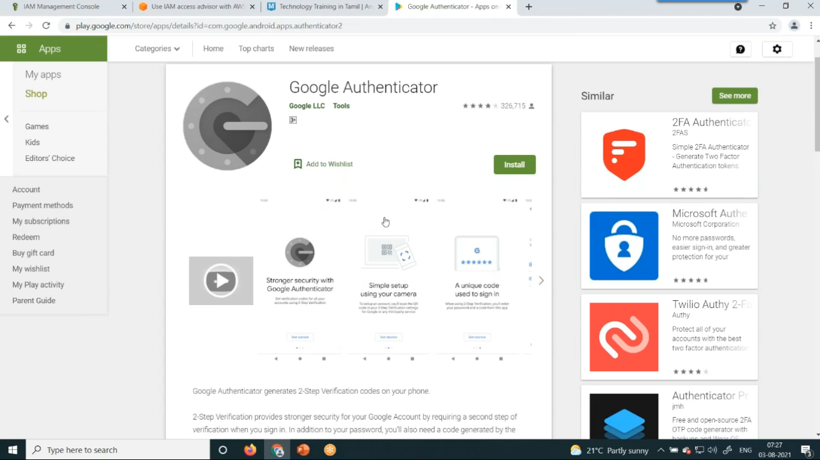

Slide 17
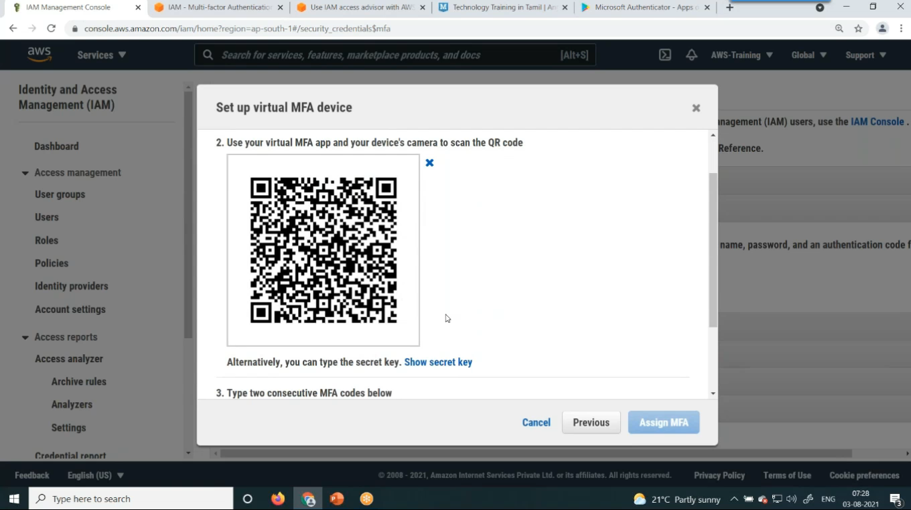

Slide 18

Elastic BeanStalk?
AWS Elastic Beanstalk is an orchestration service offered by Amazon Web Services for deploying applications which orchestrates various AWS services, including EC2, S3, Simple Notification Service, CloudWatch, autoscaling, and Elastic Load Balancers.
Elastic Beanstalk's main benefits include
Timesaving server configuration,
Powerful customization, and
Cost-effective price point.

